Slide 1
PEACE DESIGNER SERVICE PROJECT PROGRAM

Slide 2
What a
Peace Designer
Aims For

Slide 3
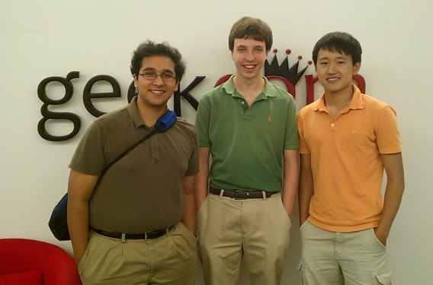
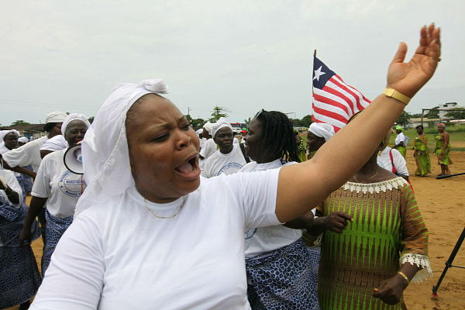
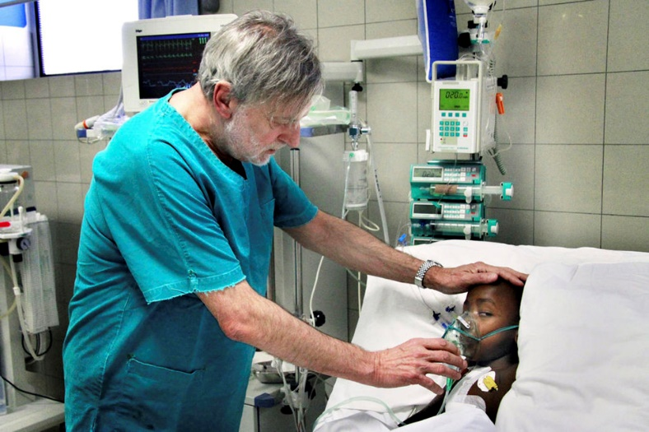
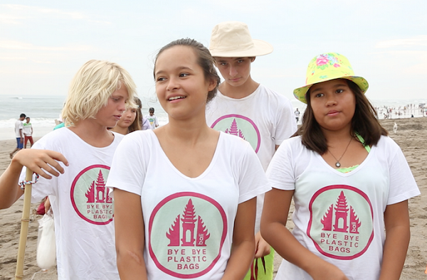
Who is a Peace Designer?
Leymah Gbowee
Sri, Singer, Lee
Melati, Isabel
Gino Strada
Notes:
Leymah Gbowee is the founder and president of Gbowee Peace Foundation Africa based in Liberia. Her foundation provides educational and leadership opportunities to girls, women and youth in West Africa. Leymah Gbowee received the Nobel Peace Prize in 2011 for her work in leading a women’s peace movement that brought an end to the Second Liberian Civil War in 2003.
Gino Strada is an Italian surgeon and an outstanding humanitarian who has provided high-quality medical and surgical services to victims of war for two decades. From Afghanistan to Sudan, EMERGENCY, the organisation that he co-founded in 1994, runs over 60 hospitals, clinics and first aid posts, often in collaboration with local governments and operating with the aim of transferring medical knowledge and expertise to local health service professionals. Strada and EMERGENCY have also campaigned forcefully against the root causes of war and human suffering, speaking out against Italian military involvement in the wars in Afghanistan and Iraq, and playing a leading role in the successful campaign that resulted in Italy banning the production and use of antipersonnel landmines in 1997.
Melati (17) and Isabel (15) Wijsen started Bye Bye Plastic Bags at the ages of 10 and 12, after being inspired by a lesson in school about significant people, like Nelson Mandela, Lady Diana, and Mahatma Ghandi. The sisters returned home that day and asked themselves, ‘What can we do as children living in Bali, NOW, to make a difference?’ Bye Bye Plastic Bags was born in 2013 and has now grown into a well known international movement of inspiration, youth empowerment, and of course, saying NO to plastic bags.

Slide 4
Who is a Peace Designer?
“A person who imagines a
peaceful society
and takes action
to realize that society”

Slide 5
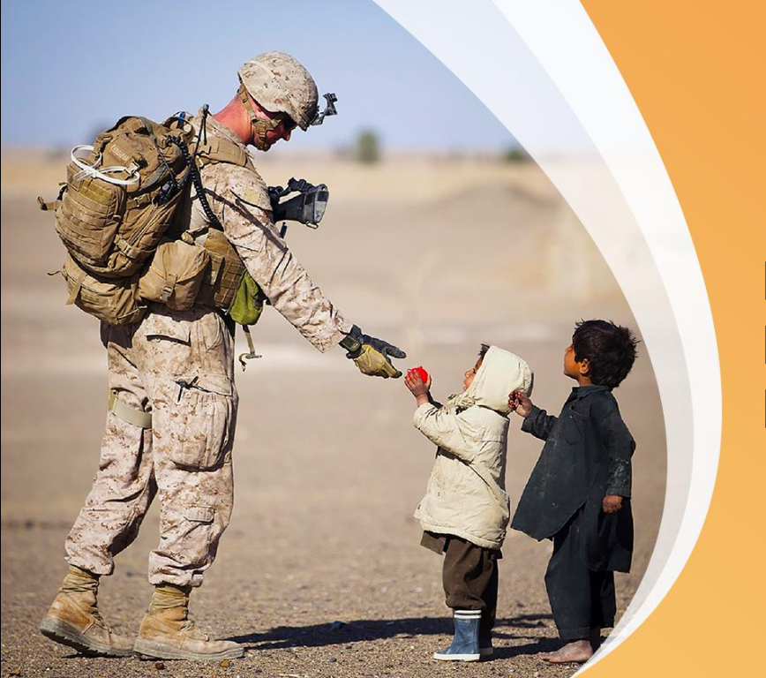
A Peace Designer Embodies Peace

Slide 6
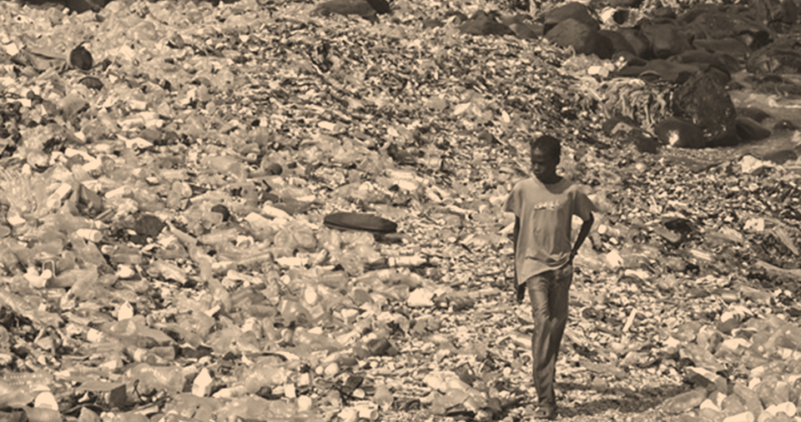
Problems in the World
Pollution
Poverty
Ethnic conflict
World Issues
Food
Education
Dispute

Slide 7


Who is going to build a Peaceful World?
Pollution
Ethnic conflict
Poverty
World Issues
We’re going to solve
them
Education
Food
Dispute
Leave it to the next Generation
Notes:
Will we take responsibility ourselves for the problems we see or wait for someone else to take care of them? As Peace designers we need to try to take responsibility for social problems together. Not as individuals.
‹#›

Slide 8
Principles of a Volunteer Activity
Autonomy
Cooperation
Public Benefit
Creativity
Stimulating one’s identity and developing one’s character

Slide 9
Educational effects of volunteer activities
  Contributing on revitalization
  Growing responsibility and sociality
  Cognition of current social situation
  Finding social issues → suggesting the
  resolutions
社会を支える担い手の認識
社会問題の理解
Awareness as
leaders of
society
Understanding
about
social issues
活動に関わる他者の理解
自分自身の理解
Understanding
Others who are
Related to
the activity
Understanding
myself
  Understanding preferences, thought, intent of others throughout the activity→ growing empathy
  Finding one’s strengths and expertise
  Growing self-affirmation
Notes:
Benefits of volunteering and leading a service project. Many skills are learned and experienced that you can apply to other situations and even for your school and work.

Slide 10
Educational benefits through the project
Win-Win
idea
Persuasive power
Planning, designing
Developing myself
project
Growth as a leader
Listening skill
Management skill
Ownership, leadership
Notes:
Leading a service project encompasses many skills which you learn and develop as you go through the process of planning and implementing your project. It can grow into self development and taking responsibility for social problems.
‹#›

Slide 11
The foundation of volunteer work is Family
One Global Family
other
acquaintance
Volunteering
Forming the role model
Expansion of family love
neighbors
friends
relatives
family
Notes:
The family is where we first learn to serve when we are young, whether it be chores or helping our family members around the house. From there it expands and ultimately leads to understanding the importance of seeing all people of the world as our family whom we want to take care of and serve.

Slide 12
IDENTIFYING PROBLEMS

Slide 13
What issues do you see in society and the world today?
Notes:
Write down a list of problems the participants see in the news and even in their communities.

Slide 14

What are the SDGs?
The Sustainable Development Goals are global goals adopted in the international summit in September 2015 as the successors to the Millenium Development Goals (MDGs) established in 2001.
Not only developing countries, but also developed countries have to work towards these goals until 2030.

Slide 15
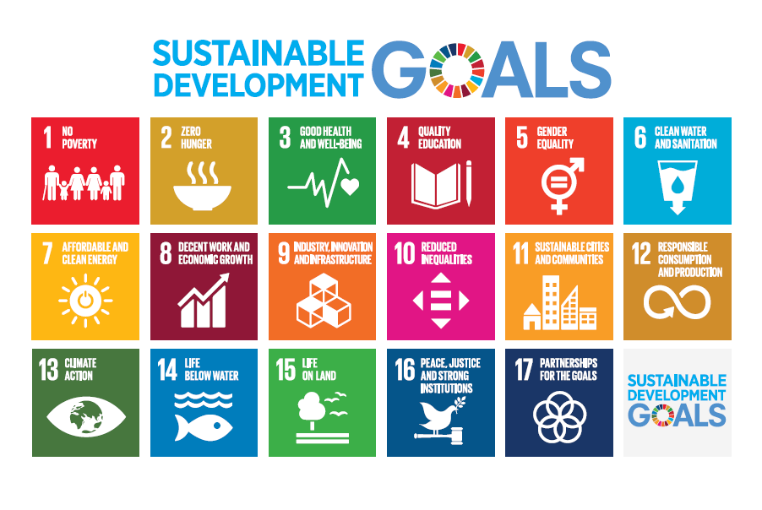

Slide 16
2001～2015
2016～2030
ＭＤＧｓ
Millennium Development Goals
ＳＤＧｓ
Sustainable Development Goals
8 Goals・21 Targets
（simple and clear）
Goals for developing countries
Led by UN experts
17 Goals・169 targets
（comprehensive and related to each other）
Goals for all countries
（＝universality）
All UN member states negotiated and approved
Implemental method
（fund・skill）
Notes:
In September 2000, leaders of 189 countries gathered at the United Nations headquarters and signed the historic Millennium Declaration, in which they committed to achieving a set of eight measurable goals that range from halving extreme poverty and hunger to promoting gender equality and reducing child mortality, by the target date of 2015.
The Sustainable Development Goals (SDGs) are a collection of 17 global goals set by the United Nations in 2015. "Global Goals for Sustainable Development" is another name used. The goals are broad and somewhat interdependent, yet each has a separate list of targets to achieve. Achieving all 169 targets would signal accomplishing all 17 goals. The SDGs cover social and economic development issues including poverty, hunger, health, education, climate change, gender equality, water, sanitation, energy, urbanization, environment and social justice.

Slide 17
What SDGs are the issues you listed connected to?
Notes:
(Based on the 17 SDGs have participants list which one’s they think are connected to the list of problems and issues they made earlier.)

Slide 18
Peace Design vs. Service Project Design
Notes:
The difference between a PD and a service project designer is that a PD seeks to build peace through the project in the target community .Some service projects only address the symptoms of a problem, while PD tries to address the issue’s core through an understanding of its ultimate root in human nature.

Slide 19
What is Peace Design?
To design plans which address social issues and to solve problems by sharing the goal and process with people related to the issue.
Notes:
It should involve you, your team, other collaborators involved or interested in the issue, and those affected by the issue.

Slide 20
Questions to ask yourself
What level of service do you want to do?
What outcome is your goal? (solve a major social issue, give service experience to young people, bring awareness to an existing issue, etc.)

Slide 21
PUTTING TOGETHER A PEACE PROJECT

Slide 22
4 PARTS
Clarifying the Problem
Define the Solution
Create an Action Plan
Planning the Assessment

Slide 23
Clarifying the Problem

Slide 24
List issues, then prioritize
Find out what is needed in your community
When choosing a project consider what you are capable of and how much time you can invest. Be honest with yourself.

Slide 25
Research
What organizations or groups might be addressing this issue?
What has been done about it in the past?

Slide 26
Root Cause Analysis
“5 WHY Analysis”
Method to find the root cause of the issue by asking ‘Why’ five times

Slide 27

Example
Root Cause Analysis
Intense Corrosion of Jefferson Memorial
1 WHY? Because the stone is often cleaned with soap water.
2 WHY? Many pigeons leave their droppings around the memorial.
3 WHY? The pigeons come to eat many spiders.
4 WHY? The spiders eat moths.
5 WHY? The moths gather at the memorial electric light when the sun goes down.
Solution: Turn off the light 2 hours after the sun goes down.
Notes:
This process helps us realize what actually is the source of the problem, and in some cases it may be something simple to solve. Asking “Why” several times also shows that if we stopped at the first “why” we would have come up with a different solution (i.e. use different cleaning agent), and if we stopped a the 2nd “why” we would have thought about how to get rid of pigeons and so on.

Slide 28
2. Define the Solution

Slide 29
What is the outcome/end goal you want to see from this project?
Does it solve the root problem and promote peace?
Is it realistic?

Slide 30
Tips for a Successful Peace Project
Strong motivation and desire by the project proposer or team
The idea makes sense and can be measurable
Well thought-out action plan

Slide 31
3. Create an Action Plan
Notes:
(Have participants answer each of the following questions for their peace project)

Slide 32
See What You Have the Ability to Do
What skills and talents do you have?
How many people do you realistically think you will be able to get to help you?
What skills and talents will they have?
How many hours per week can you devote to the project?
How soon do you want to do the project?
What is a realistic amount of money you will be able to raise for the project?
Do you have any materials at hand that will be helpful?
https://blog.prepscholar.com/community-service-projects
Notes:
This and the following slides are steps from a prescholar blog on creating a successful service project in order to help your school credentials. When you plan and put together a service project for your community you exemplify many qualities of leadership and self discipline that are desired from students so it looks good on your school resume.

Slide 33
Develop a Practical Plan
What small steps do you need to take to get to your end goal?
How much equipment will you need?
How many people will you need to successfully complete the project?
How much time can they commit and how will you organize them? (Delegation)
What safety and legal issues might be potential complications?
How will you measure your progress and success?

Slide 34
Recruit People
Make a list of people you can reach out to
Advertise in local newspapers or online
Find out exactly how much time and when each volunteer can commit.

Slide 35
Make a Timeline
Pick an end date that gives you enough time to prepare your project
Include when certain volunteers can help before and on the day of the project
When will you fundraise?
When will you advertise?
How much do you want done by certain dates in your timeline?

Slide 36
Budget
Be specific: List what items you will need, how many of each item, cost of each item, total cost.
Keep in mind things like transportation and food cost for volunteers.
Consider non-physical items such as license/permits you might need to hold an event, or paying for an entertainer, etc.

Slide 37
Raise Money
Street collection
Organized raffles or auctions
Crowdfunding (gofundme, kickstarter)
Asking for donations through church newsletter
Business sponsorship
Grants
Try to get money from different sources so you are not relying on just one.

Slide 38
Get Publicity
Make a list of contacts at TV stations, newspapers, blogs, magazines, and radio stations. You are generally looking for journalists and editors.
Advertise yourself through social media (twitter, facebook, etc.)
Keep both updated on your project’s progress and milestones

Slide 39
Do the Project
Make sure as much as possible is done and set up the day before the event.
Send lots of reminders the day before to volunteers, participants, media and anyone else who is involved.
Have a detailed schedule, volunteer contact list, vendor contact list and a list of who to contact for emergencies. Keep these with you at all times.
Take pictures and stay active on social media.
Try to stay on top of how things are progressing and have fun!

Slide 40
4. Planning the Assessment
Notes:
After you do your project, reflecting and assessing the event is just as important as doing it. This way you find out what went well, why did it go well, and what didn’t go well and why so you are better prepared for your next project or phase as you continue moving forward.

Slide 41
After the Event
Get team and volunteer feedback.
What went well? Why?
What didn’t go well? Why?
What can be improved?
Did you help your target group? Did you meet your goals?
Was your measurable outcome clear?
What did you learn about yourself?
What next steps will you take for this issue?
Notes:
Questions to ask your volunteers, team and yourself.

Slide 42
Remember to Celebrate. You’ve just undertaken and accomplished something that many people would shy away from. Be proud of what you’ve achieved!

Slide 43
FINAL PRESENTATION
What issue do you plan to tackle?
Why is this issue important to you?
What SDG’s do you think it’s connected to?
How will you address the problem?
What outcome do you want?
What steps will you take?
How will you measure your success?
Notes:
(Each participant presents their idea and plan for a peace project.)

Slide 44
Peace Designer Workshop Feedback
What did you like about the Peace Designer workshop?
What could be improved?
What peace project are you excited to work on ?
On a scale of 1-5 (5 great, 1 terrible) how would you rate your experience
Additional comments

